Slide 1

Other articles on curiosity
How to Spark Curiosity in Children Through Embracing Uncertainty
How to Stimulate Curiosity
5 Learning Strategies That Make Students Curious
How Can Teachers Foster Curiosity?
The Case for Curiosity

Slide 2
Discuss:
What is curiosity? What does it mean to be curious?
Is curiosity a good thing? Why/why not?
How do we develop curiosity? What would make a person more/less curious?

Slide 3
Did Curiosity Kill the Cat?
http://www.lifehack.org/articles/productivity/4-reasons-why-curiosity-is-important-and-how-to-develop-it.html

Slide 4
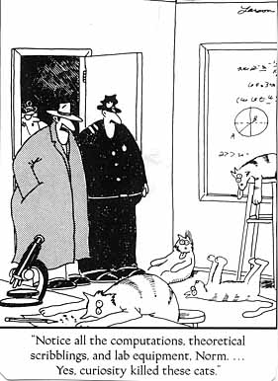
Is this true?
The Far Side, Gary Larson

Slide 5
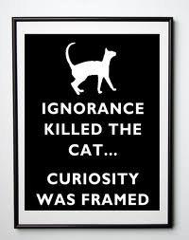
Or this?
Linked2leadership

Slide 6
What do you think?
Is curiosity good or bad? Why do you think this? Support your answer.
Notes:
Have kids decide and discuss – could have them line up according to their belief, debate the sides

Slide 7
Guiding Questions:
What is curiosity?
What kinds of things would interact with curiosity?
How would those things interact?
Notes:
Go through guiding questions for the articles they’ll be reading.

Slide 8
Process:
Read the articles/information.
Keep track of things that are changing or that could change.
Create a connection circle using information from the articles.
Pull loops out of the connection circle.
Notes:
Go through quickly – can read the articles together or have them read independently (put on pdf). Goal is to read and keep track of things that change or could change: curiosity, open-mindedness, asking questions, knowledge, achievement, etc.

Slide 9
“4 Reasons Why Curiosity is Important and How to Develop It” By Donald Latumahina http://www.lifehack.org/articles/productivity/4-reasons-why-curiosity-is-important-and-how-to-develop-it.html
The important thing is not to stop questioning… Never lose a holy curiosity. Albert Einstein
Curiosity is an important trait of a genius. I don’t think you can find an intellectual giant who is not a curious person. Thomas Edison, Leonardo da Vinci, Albert Einstein, Richard Feynman, they are all curious characters. Richard Feynman was especially known for his adventures which came from his curiosity.
But why is curiosity so important? Here are four reasons:
It makes your mind active instead of passive Curious people always ask questions and search for answers in their minds. Their minds are always active. Since the mind is like a muscle which becomes stronger through continual exercise, the mental exercise caused by curiosity makes your mind stronger and stronger.

Slide 10
It makes your mind observant of new ideas When you are curious about something, your mind expects and anticipates new ideas related to it. When the ideas come they will soon be recognized. Without curiosity, the ideas may pass right in front of you and yet you miss them because your mind is not prepared to recognize them. Just think, how many great ideas may have been lost due to lack of curiosity?
It opens up new worlds and possibilities By being curious you will be able to see new worlds and possibilities which are normally not visible. They are hidden behind the surface of normal life, and it takes a curious mind to look beneath the surface and discover these new worlds and possibilities.
It brings excitement into your life The life of curious people is far from boring. It’s neither dull nor routine. There are always new things that attract their attention, there are always new ‘toys’ to play with. Instead of being bored, curious people have an adventurous life.

Slide 11
Now, knowing the importance of curiosity, here are some tips to develop it:
1. Keep an open mind.
This is essential if you are to have a curious mind. Be open to learn, unlearn, and relearn. Some things you know and believe might be wrong, and you should be prepared to accept this possibility and change your mind.
2. Don’t take things as granted.
If you just accept the world as it is without trying to dig deeper, you will certainly lose the ‘holy curiosity’. Never take things as granted. Try to dig deeper beneath the surface of what is around you.
3. Ask questions relentlessly.
A sure way to dig deeper beneath the surface is asking questions: What is that? Why is it made that way? When was it made? Who invented it? Where does it come from? How does it work? What, why, when, who, where, and how are the best friends of curious people.

Slide 12
4. Don’t label something as boring.
Whenever you label something as boring, you close one more door of possibilities. Curious people are unlikely to call something as boring. Instead, they always see it as a door to an exciting new world. Even if they don’t yet have time to explore it, they will leave the door open to be visited another time.
5. See learning as something fun.
If you see learning as a burden, there’s no way you will want to dig deeper into anything. That will just make the burden heavier. But if you think of learning as something fun, you will naturally want to dig deeper. So look at life through the glasses of fun and excitement and enjoy the learning process..
6. Read diverse kinds of reading.
Don’t spend too much time on just one world; take a look at other worlds. It will introduce you to the possibilities and excitement of the other worlds which may spark your interest to explore them further. One easy way to do this is through reading diverse kinds of reading. Try to pick a book or magazine on a new subject and let it feed your mind with the excitement of a new world.

Slide 13
“Curious about Curiosity” By: Ben Dean, PhD https://www.authentichappiness.sas.upenn.edu/newsletters/authentichappinesscoaching/curiosity
This week’s featured strength is Curiosity.
Definition
Curious people have an ongoing, intrinsic interest in both their inner experience and the world around them. Curious people tend to be attracted to new people, new things, and new experiences, and they are rarely bored.
Everyone possesses curiosity to some degree. People differ according to the strength and breadth of their curiosity and their willingness to act on it. (How motivated are you by your curiosity? Are you curious in one domain or across many domains?)

Slide 14
Benefits of Curiosity
Curiosity benefits our social and romantic lives. Curious people are often considered good listeners and conversationalists. In the early stages of a relationship, we tend to talk about our interests or hobbies. One reason for this is that people tend to equate “having many interests” with “interesting,” and for good reason. Curious people tend to bring fun and novelty into relationships.
Curiosity is associated with intelligence and problem-solving ability. Although researchers have not identified the precise pathway by which curiosity leads to cognitive growth, a likely explanation concerns the rich environment curious people create for themselves as they seek new experiences and explore new ideas. Put simply, curious brains are active brains, and active brains become smart brains.
Curiosity is associated with high performance in both academic and work settings. There is evidence to suggest an upward spiraling relationship between curiosity and knowledge. The more we learn, the more we want to learn, and so on.

Slide 15
The Downside to Curiosity: When Curiosity Kills the Cat
Curiosity in the absence of good judgment can lead to trouble. Do you recall Jessica Fletcher, the author/amateur sleuth from the television series “Murder She Wrote”? Without fail, toward the end of every episode, Jessica Fletcher’s curiosity led her to confront a dangerous criminal in a remote area. Unfortunately for us, the police don’t always rush in at the last minute in real life!
When curiosity clashes with social norms, further trouble can ensue. Anyone with a small child needs no further elaboration on this point. Curiosity can motivate the youngster to ask questions such as, “Why don’t you have any children?” or “Is that man’s belly big because he’s pregnant?”

Slide 16
Building Curiosity
All things considered, the benefits of curiosity far outweigh the possible risks. Cultivating this strength can lead to both personal and professional rewards. So how might we go about developing this strength? One idea comes from the work by Mihalyi Csikszentmihalyi, one of the founders of the field of positive psychology and a pioneering researcher in the area of flow.
According to Cskikszentmihalyi, there is a direct relationship between our attentional resources and our interest in the world: Nothing is interesting to us unless we focus our attention on it. Rocks are not interesting until we begin collecting them, people in the mall are not interesting until we become curious about their lives and where they are going, and vacuum cleaners are not interesting until we need to buy a new one. According to Csikszentmihalyi, we can develop our curiosity (and fight boredom) by making a conscious effort to direct our attention to something in particular in our environment.

Slide 17
A Curiosity Challenge
I leave you with the following Curiosity Challenge. Test Csikszentmihalyi’s theory in your own lives this week. During those times when you are feeling bored or unstimulated (e.g., while waiting in line at the grocery store), focus your attention on something that ordinarily might not engage your interest. For example, if you are at the grocery store, really notice how various customers interact with the checkout clerk. Are they making eye contact or averting their gaze? Do they make small talk? Do they offer to bag their own groceries? Notice how much effort you need to expend to focus your attention. Is it worth it? Is there a trade off between being bored (but with no demands placed on your psychic energy) and being interested?

Slide 18
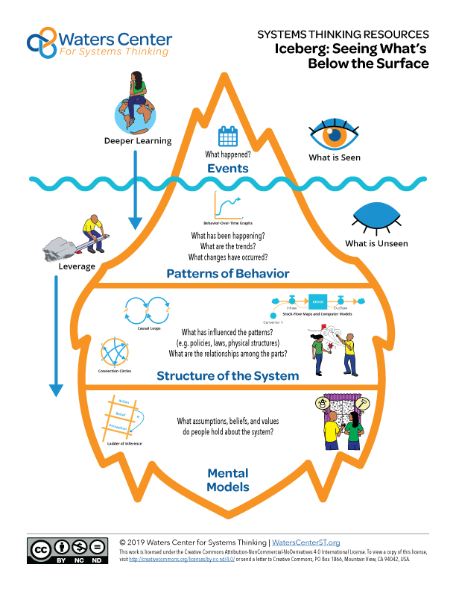
Driving Question: What set of interactions drives these changes?
Notes:
Review iceberg – focus on concept of structures/models impacting behavior- click to focus in on bottom layers)

Slide 19
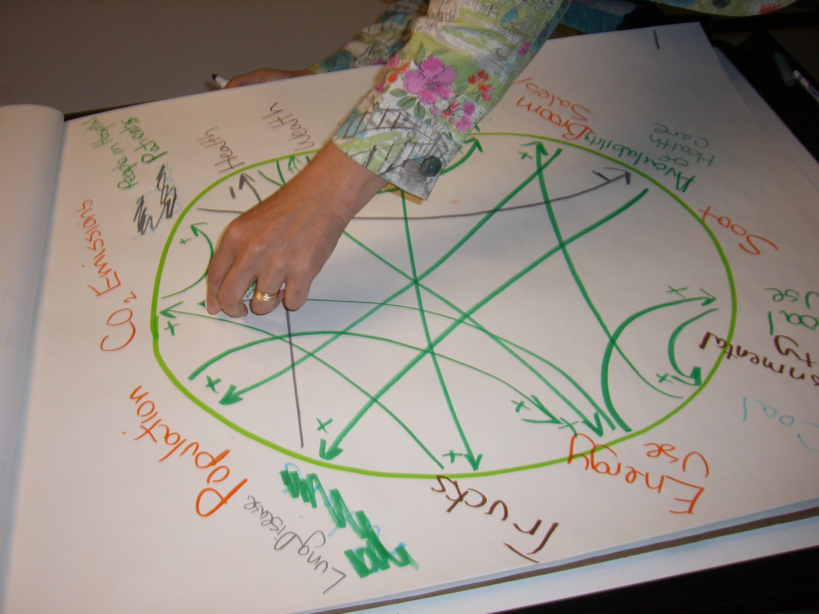
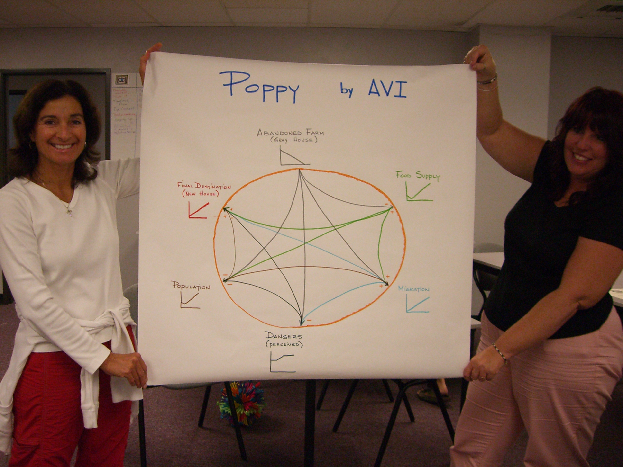
Connection Circles
Connection circles are thinking tools designed to help students understand complexity. Using connection circles as graphic organizers, students generate ideas about changing conditions within a system. They choose the elements they think are most important to the change and draw arrows to trace cause and effect relationships. Quaden and Ticotsky, The Shape of Change
©2018 Waters Foundation, watersfoundation.org
Notes:
The important thing is that the connections are causal, not relational. Actually, relational would get at some element of complexity, which is the first sentence in the statement, but it wouldn’t get at the last sentence … “cause and effect.”

Slide 20
How to Make Connection Circles
Draw a circle of behavior-over-time graphs (BOTGs). Limit the number to 5 – 10.
Identify causality: elements that cause other elements to change (increase or decrease).
Find a direct cause and effect relationship.
Draw an arrow from the “cause” element to the “effect” element.
If the variables change in the same direction (both go up) make it one color and label it with a “+”.
If the variables go in opposite directions (when one goes up the other goes down) make it a different color and label with “-”.
Adapted from The Shape of Change, Ticotsky, Quaden and Lyneis.
Notes:
Brian- In step #1 it mentions to draw a circle of graphs. Although it’s best if students have an understanding of how the elements have gone up/down over time, you may choose to only use variable names around the circle. In that case, it’s even more important to “between graphs.” You can do connection circles in which you have just words written around the outside of the circle but, or if you’ll look at that eventually.

Slide 21
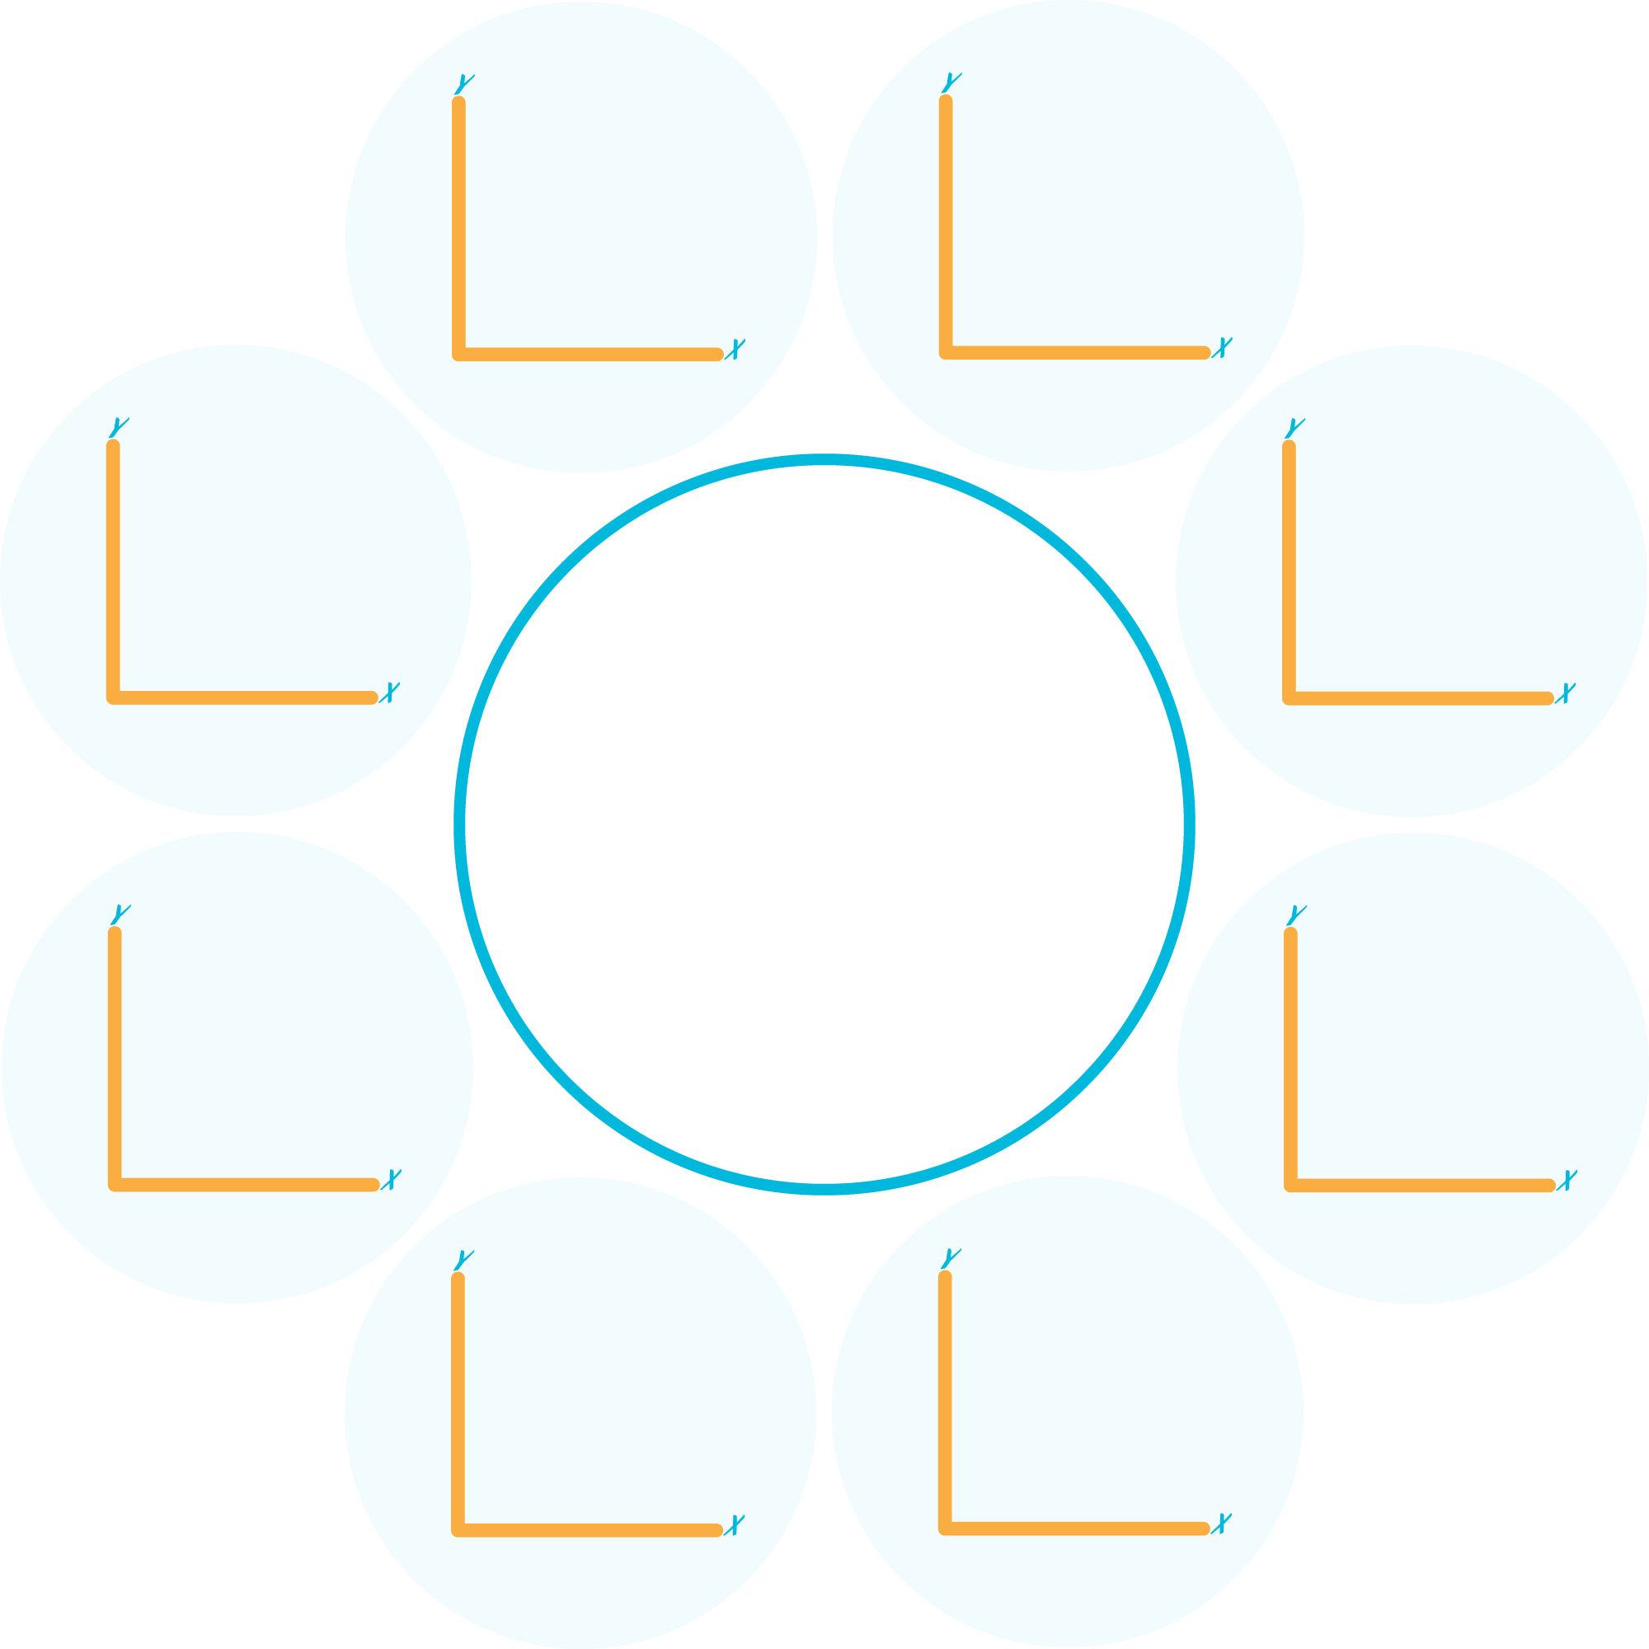
Connection Circle Template

Slide 22
Find the Loops
Reinforcing loops Balancing loops
©2018 Waters Foundation, watersfoundation.org
Notes:
Show on board while going through slides

Slide 23
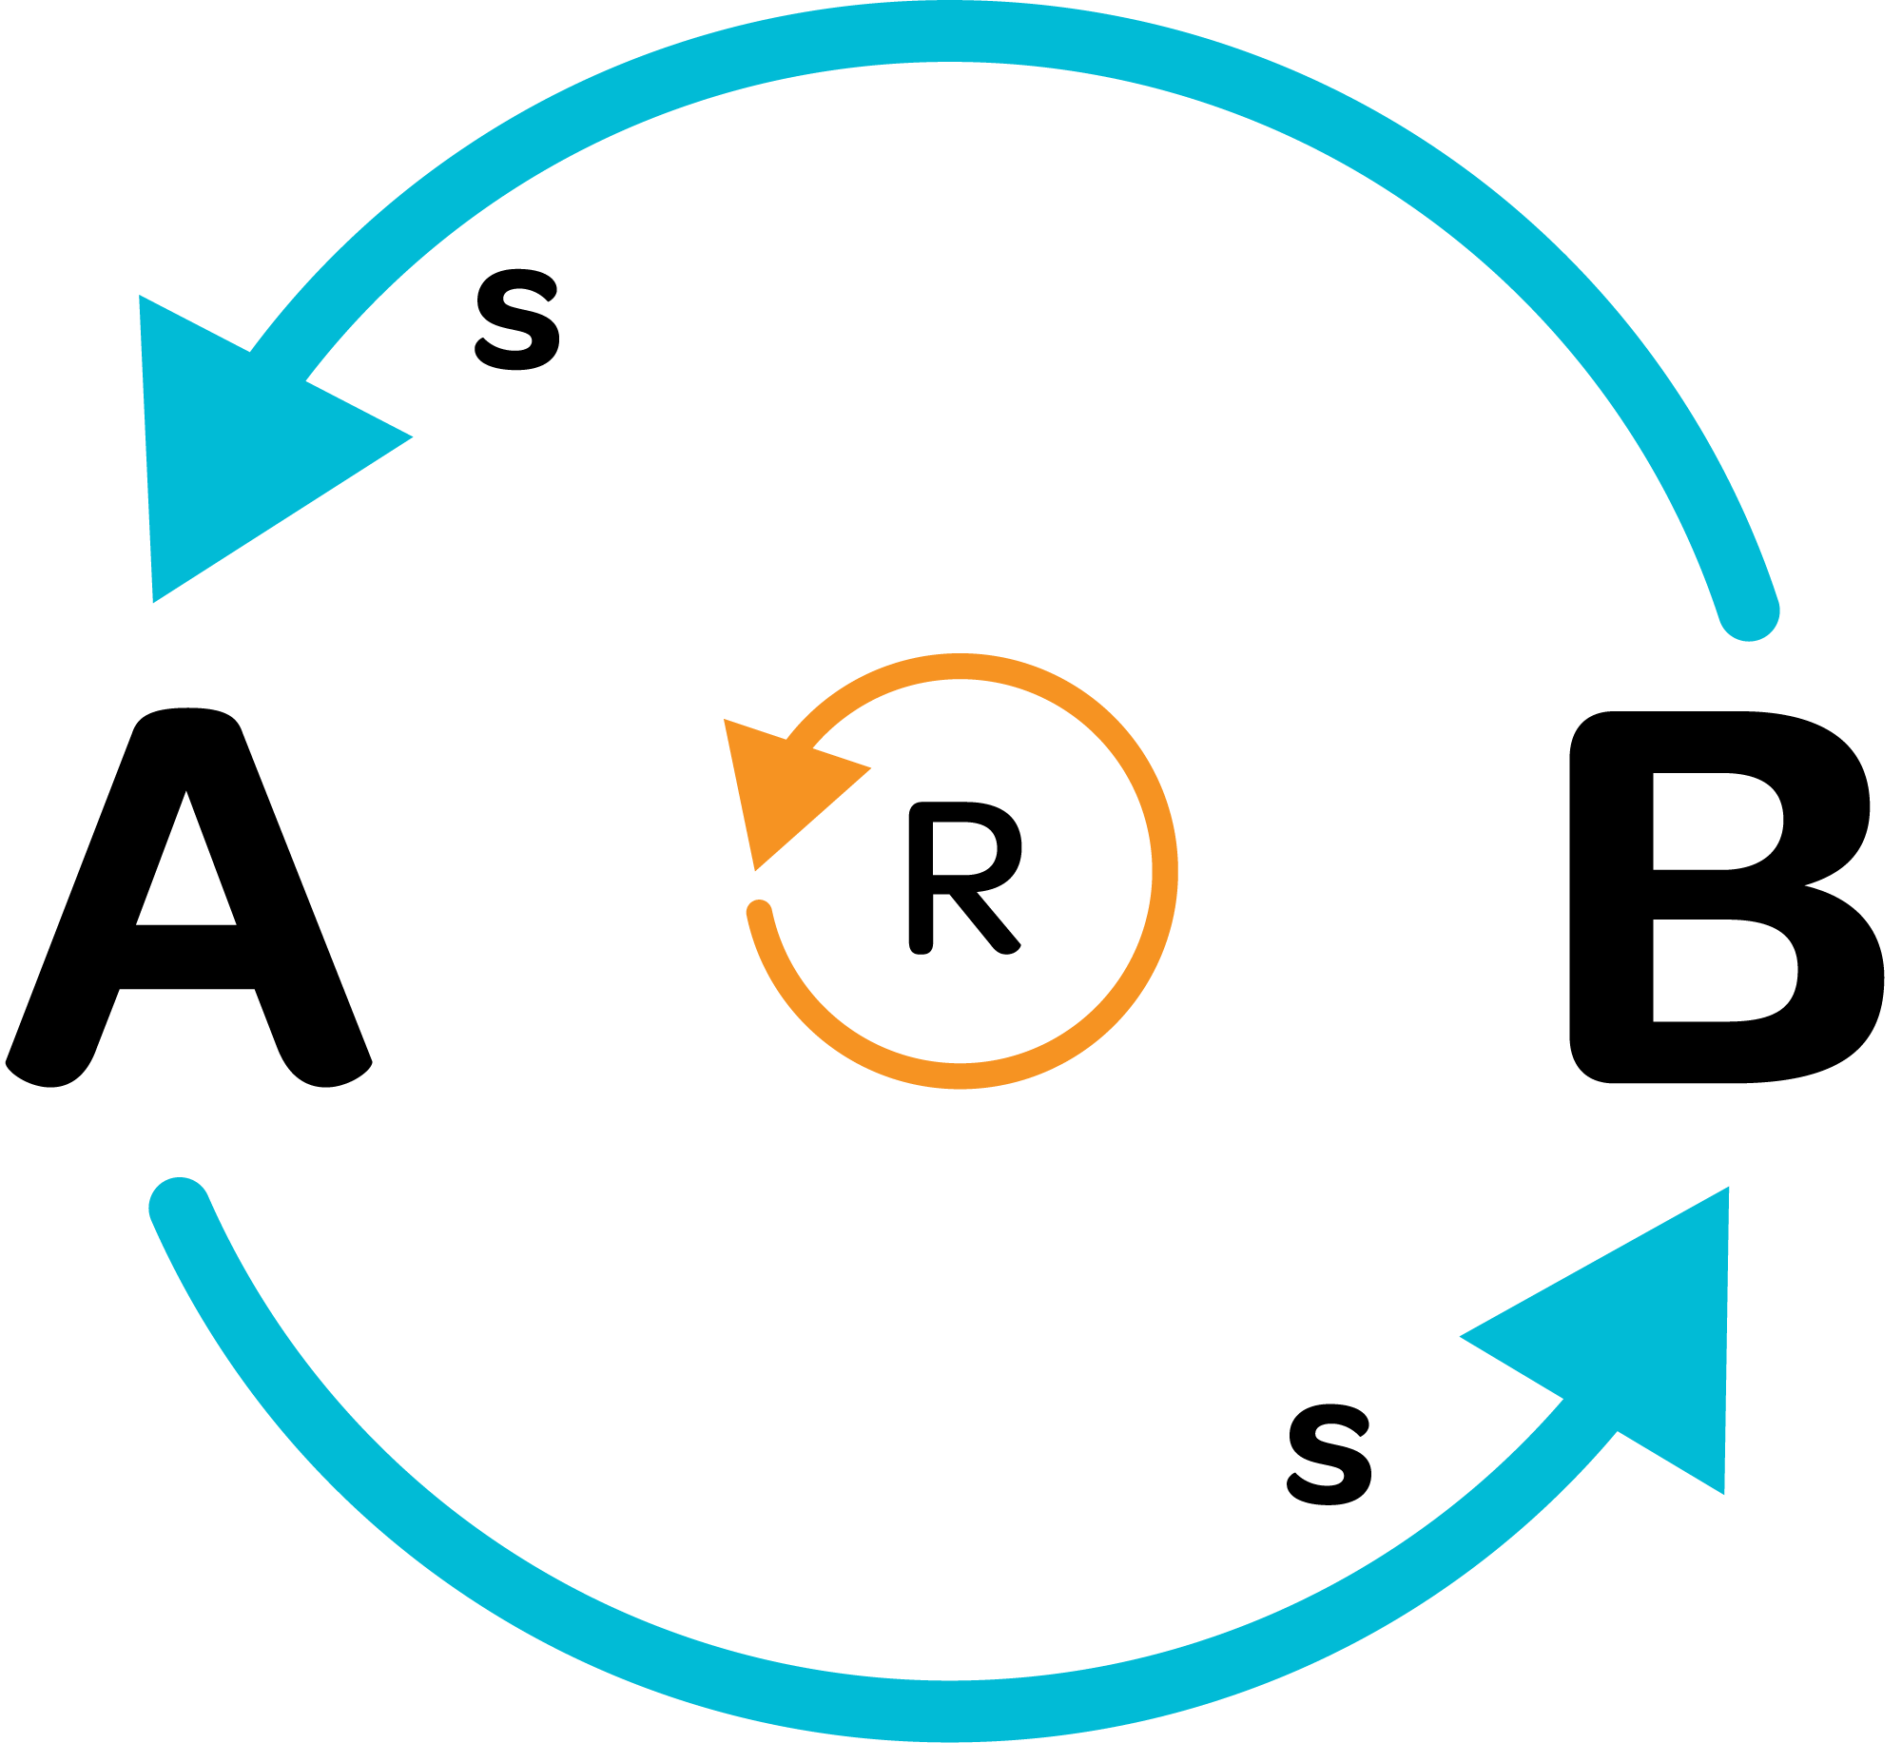
Reinforcing Feedback
“Things are getting out of control!”
“I can’t keep up!”
“We are really on a roll now!”
“The change seems to be doubling.”
R-Reinforcing Loop
B-Balancing Loop
+/s – adds to or same direction
-/o – subtracts from or opposite direction

Slide 24
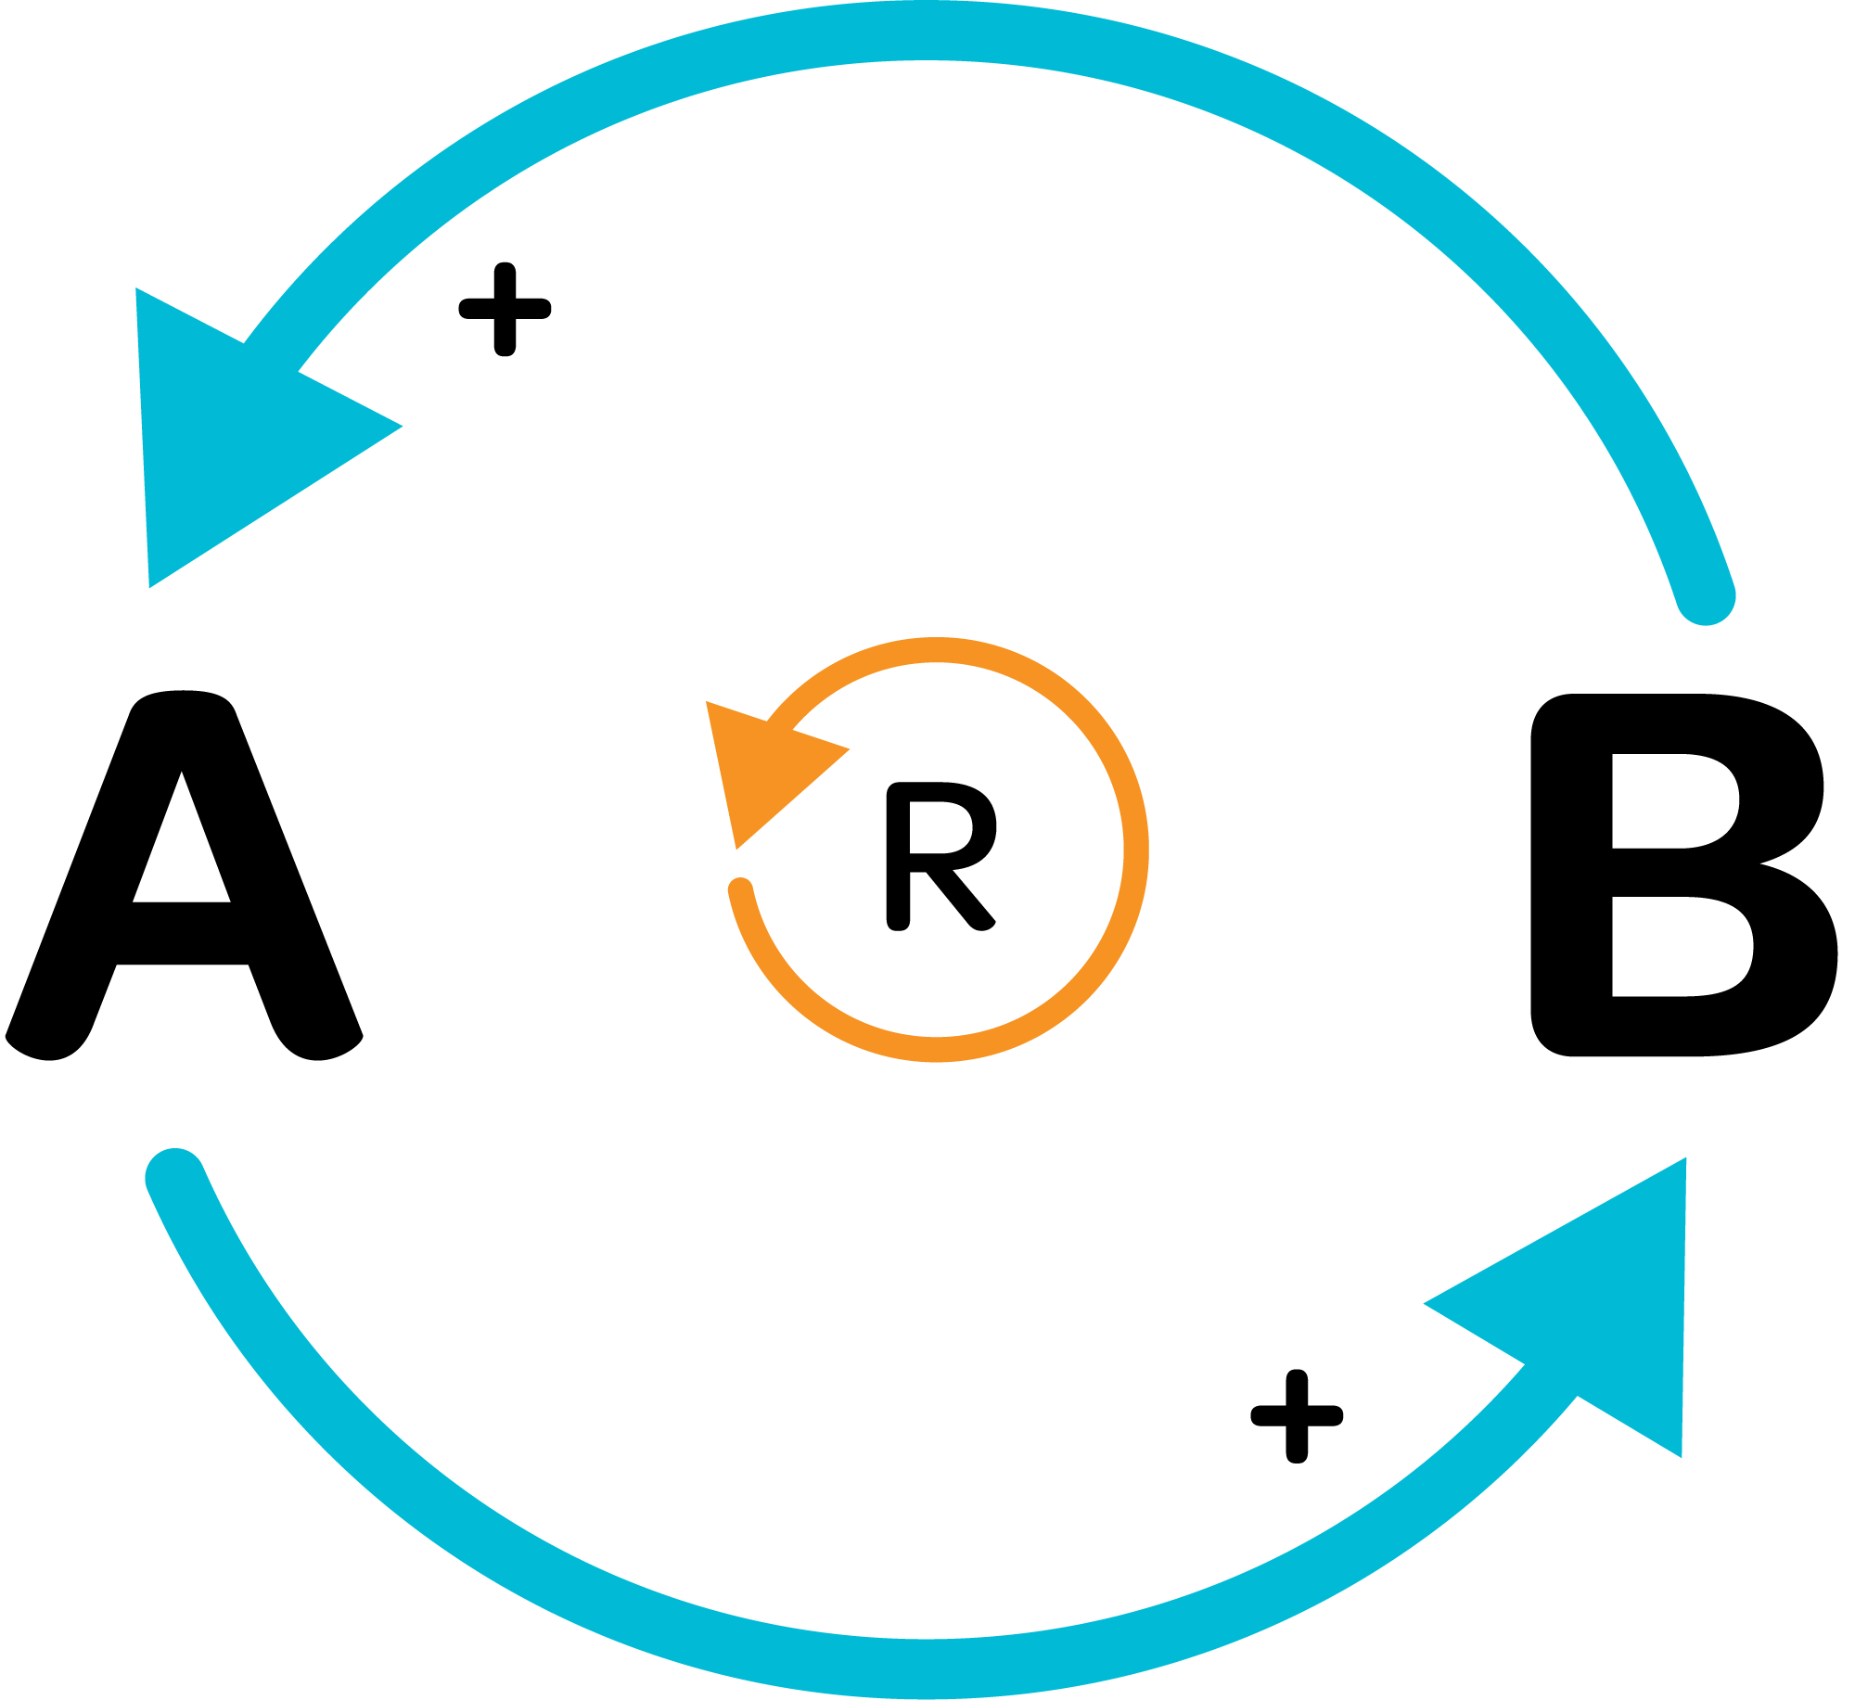
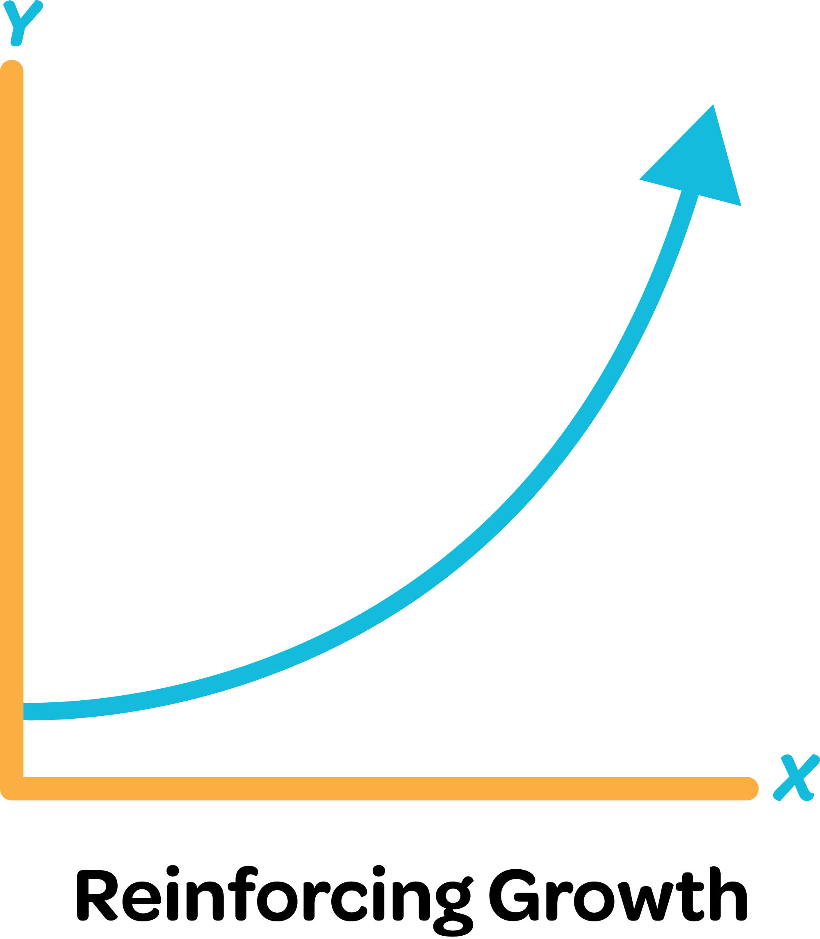
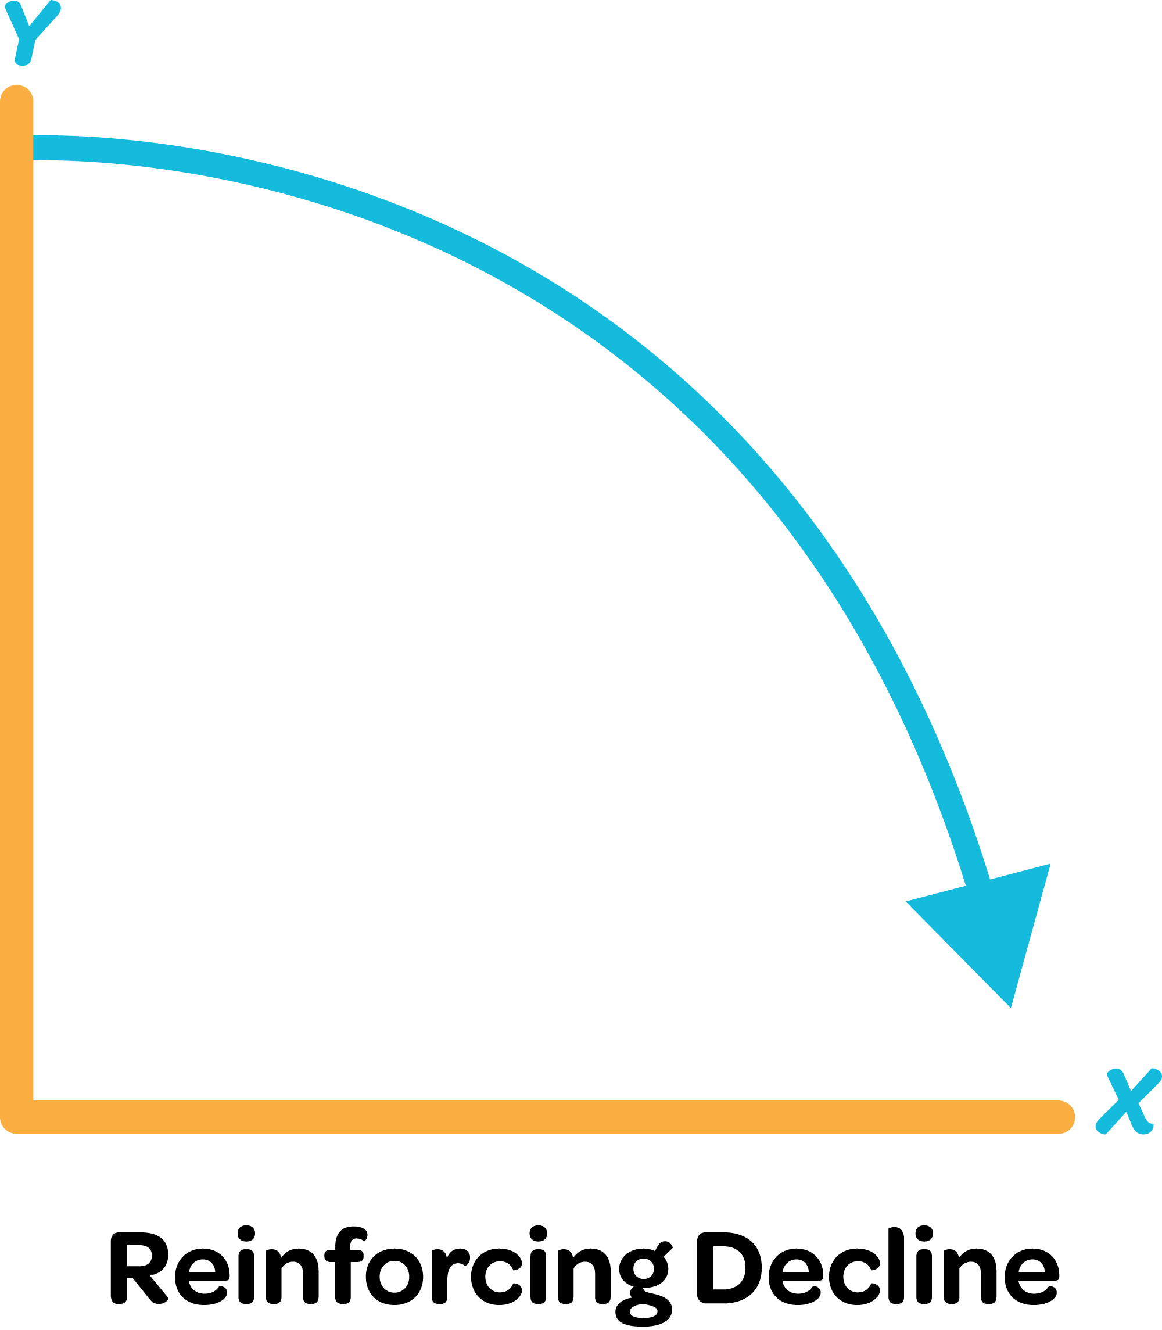
Reinforcing Feedback Behavior-Over-Time
Notes:
Lynn-

Slide 25
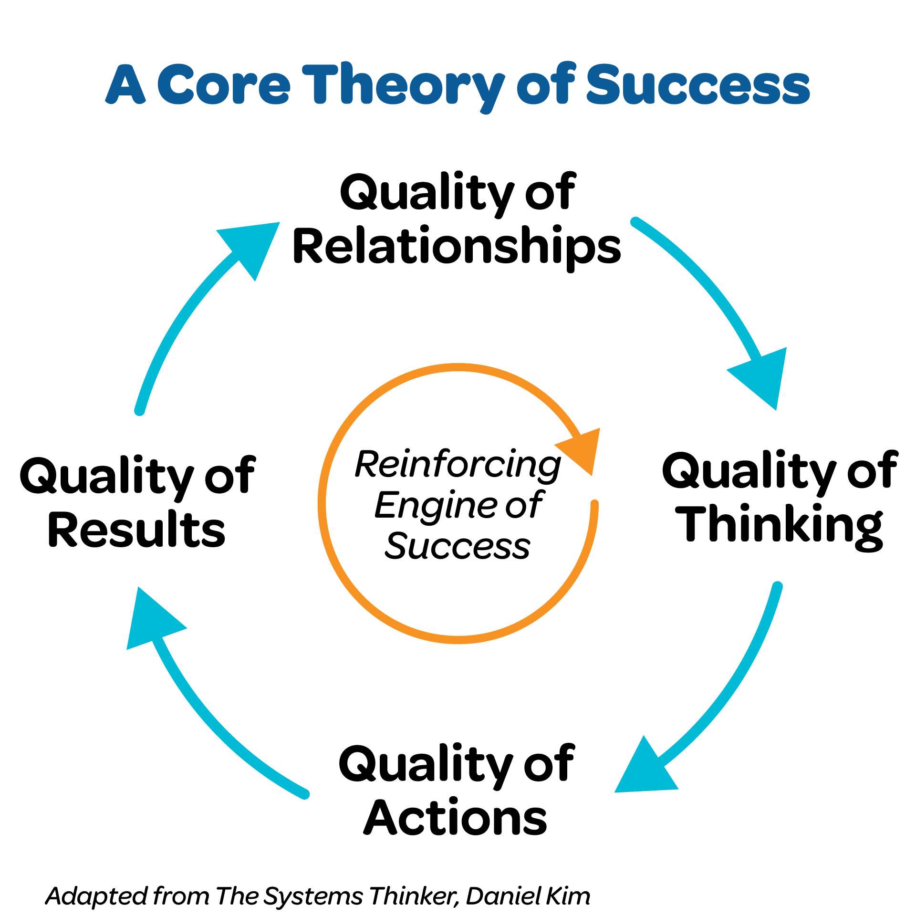
Notes:
Lynn-

Slide 26
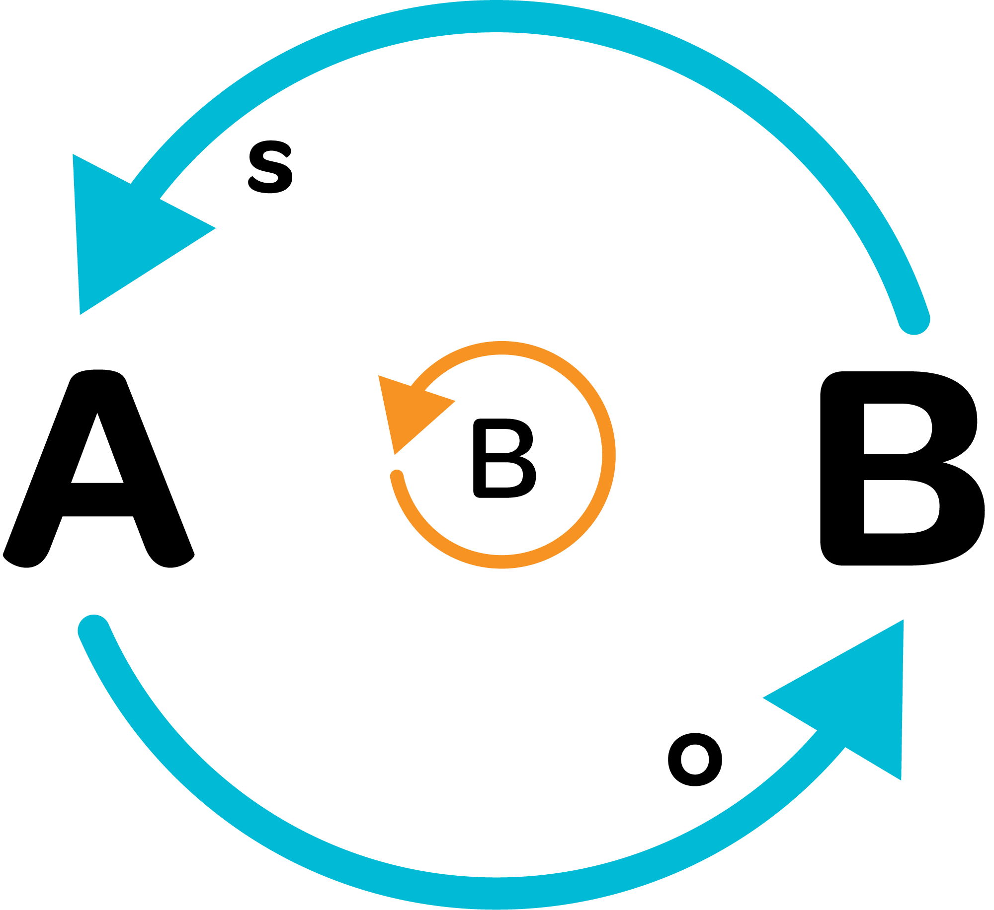
Balancing Feedback
“We are experiencing some subtle ups and downs.”
“I can sense that things are beginning to settle down.”
“We seem to be achieving balance and stability.”
“Our system is close to reaching our goals.”
Notes:
Brian- Balancing loops can produce oscillating behavior, but they can also seek an implicit or explicit goal, thus leveling out over time.

Slide 27
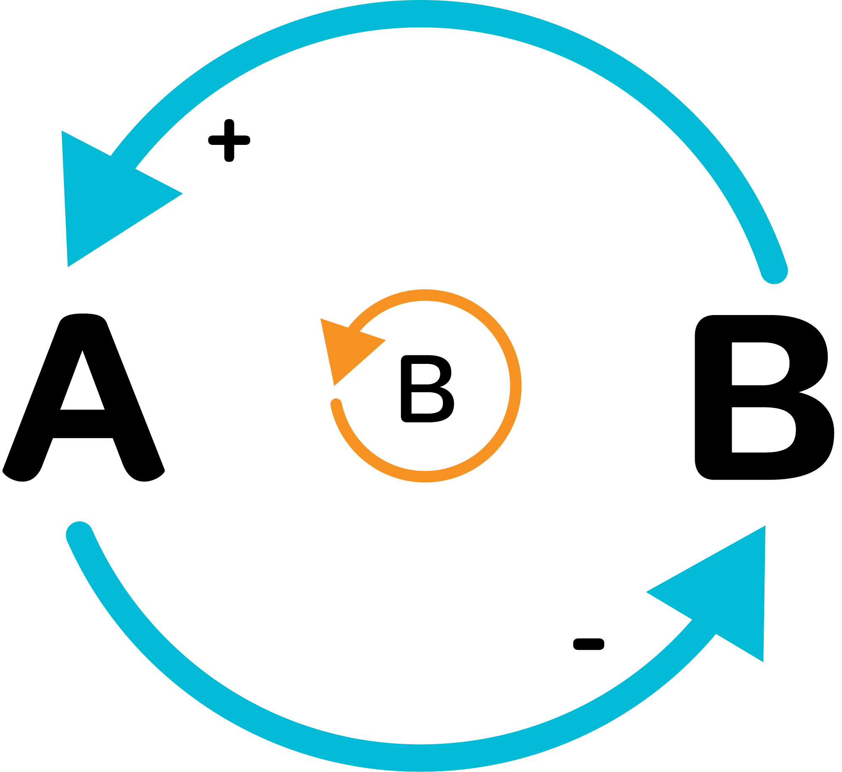
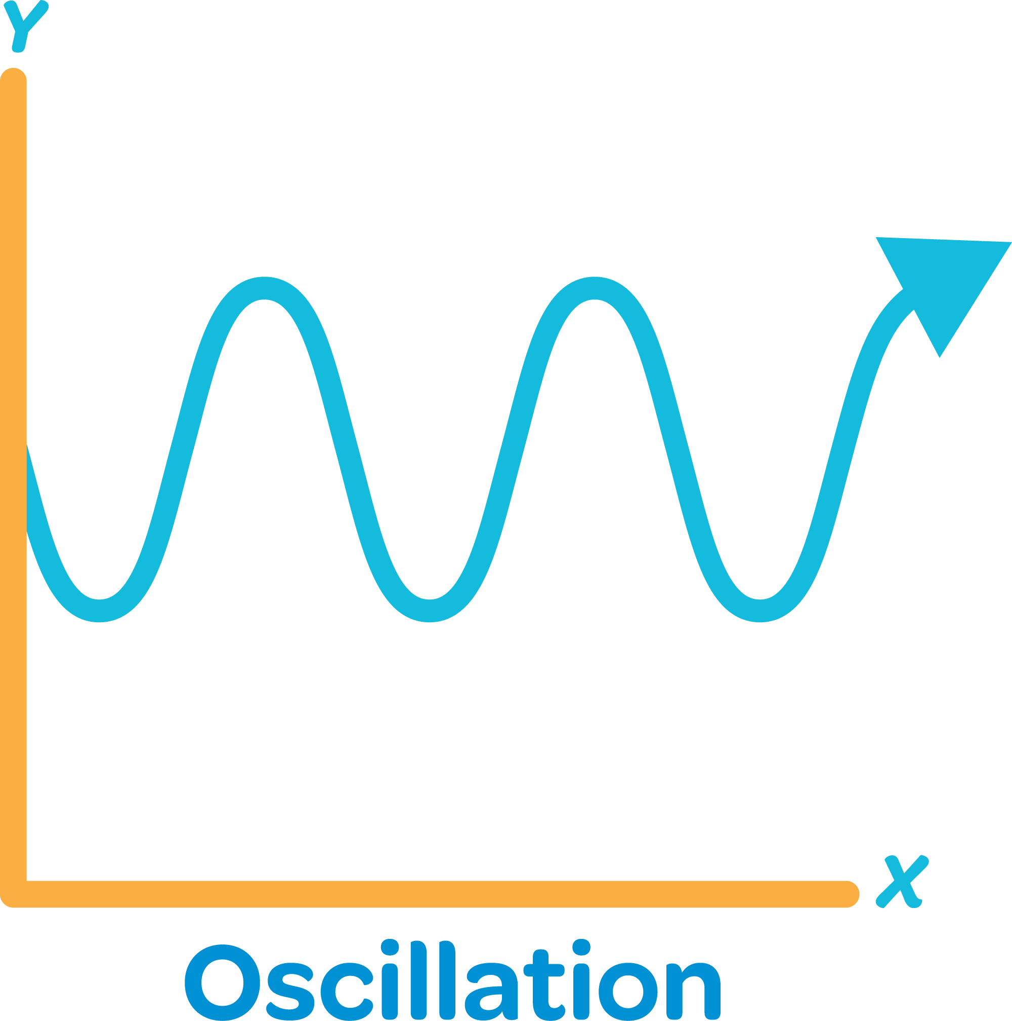
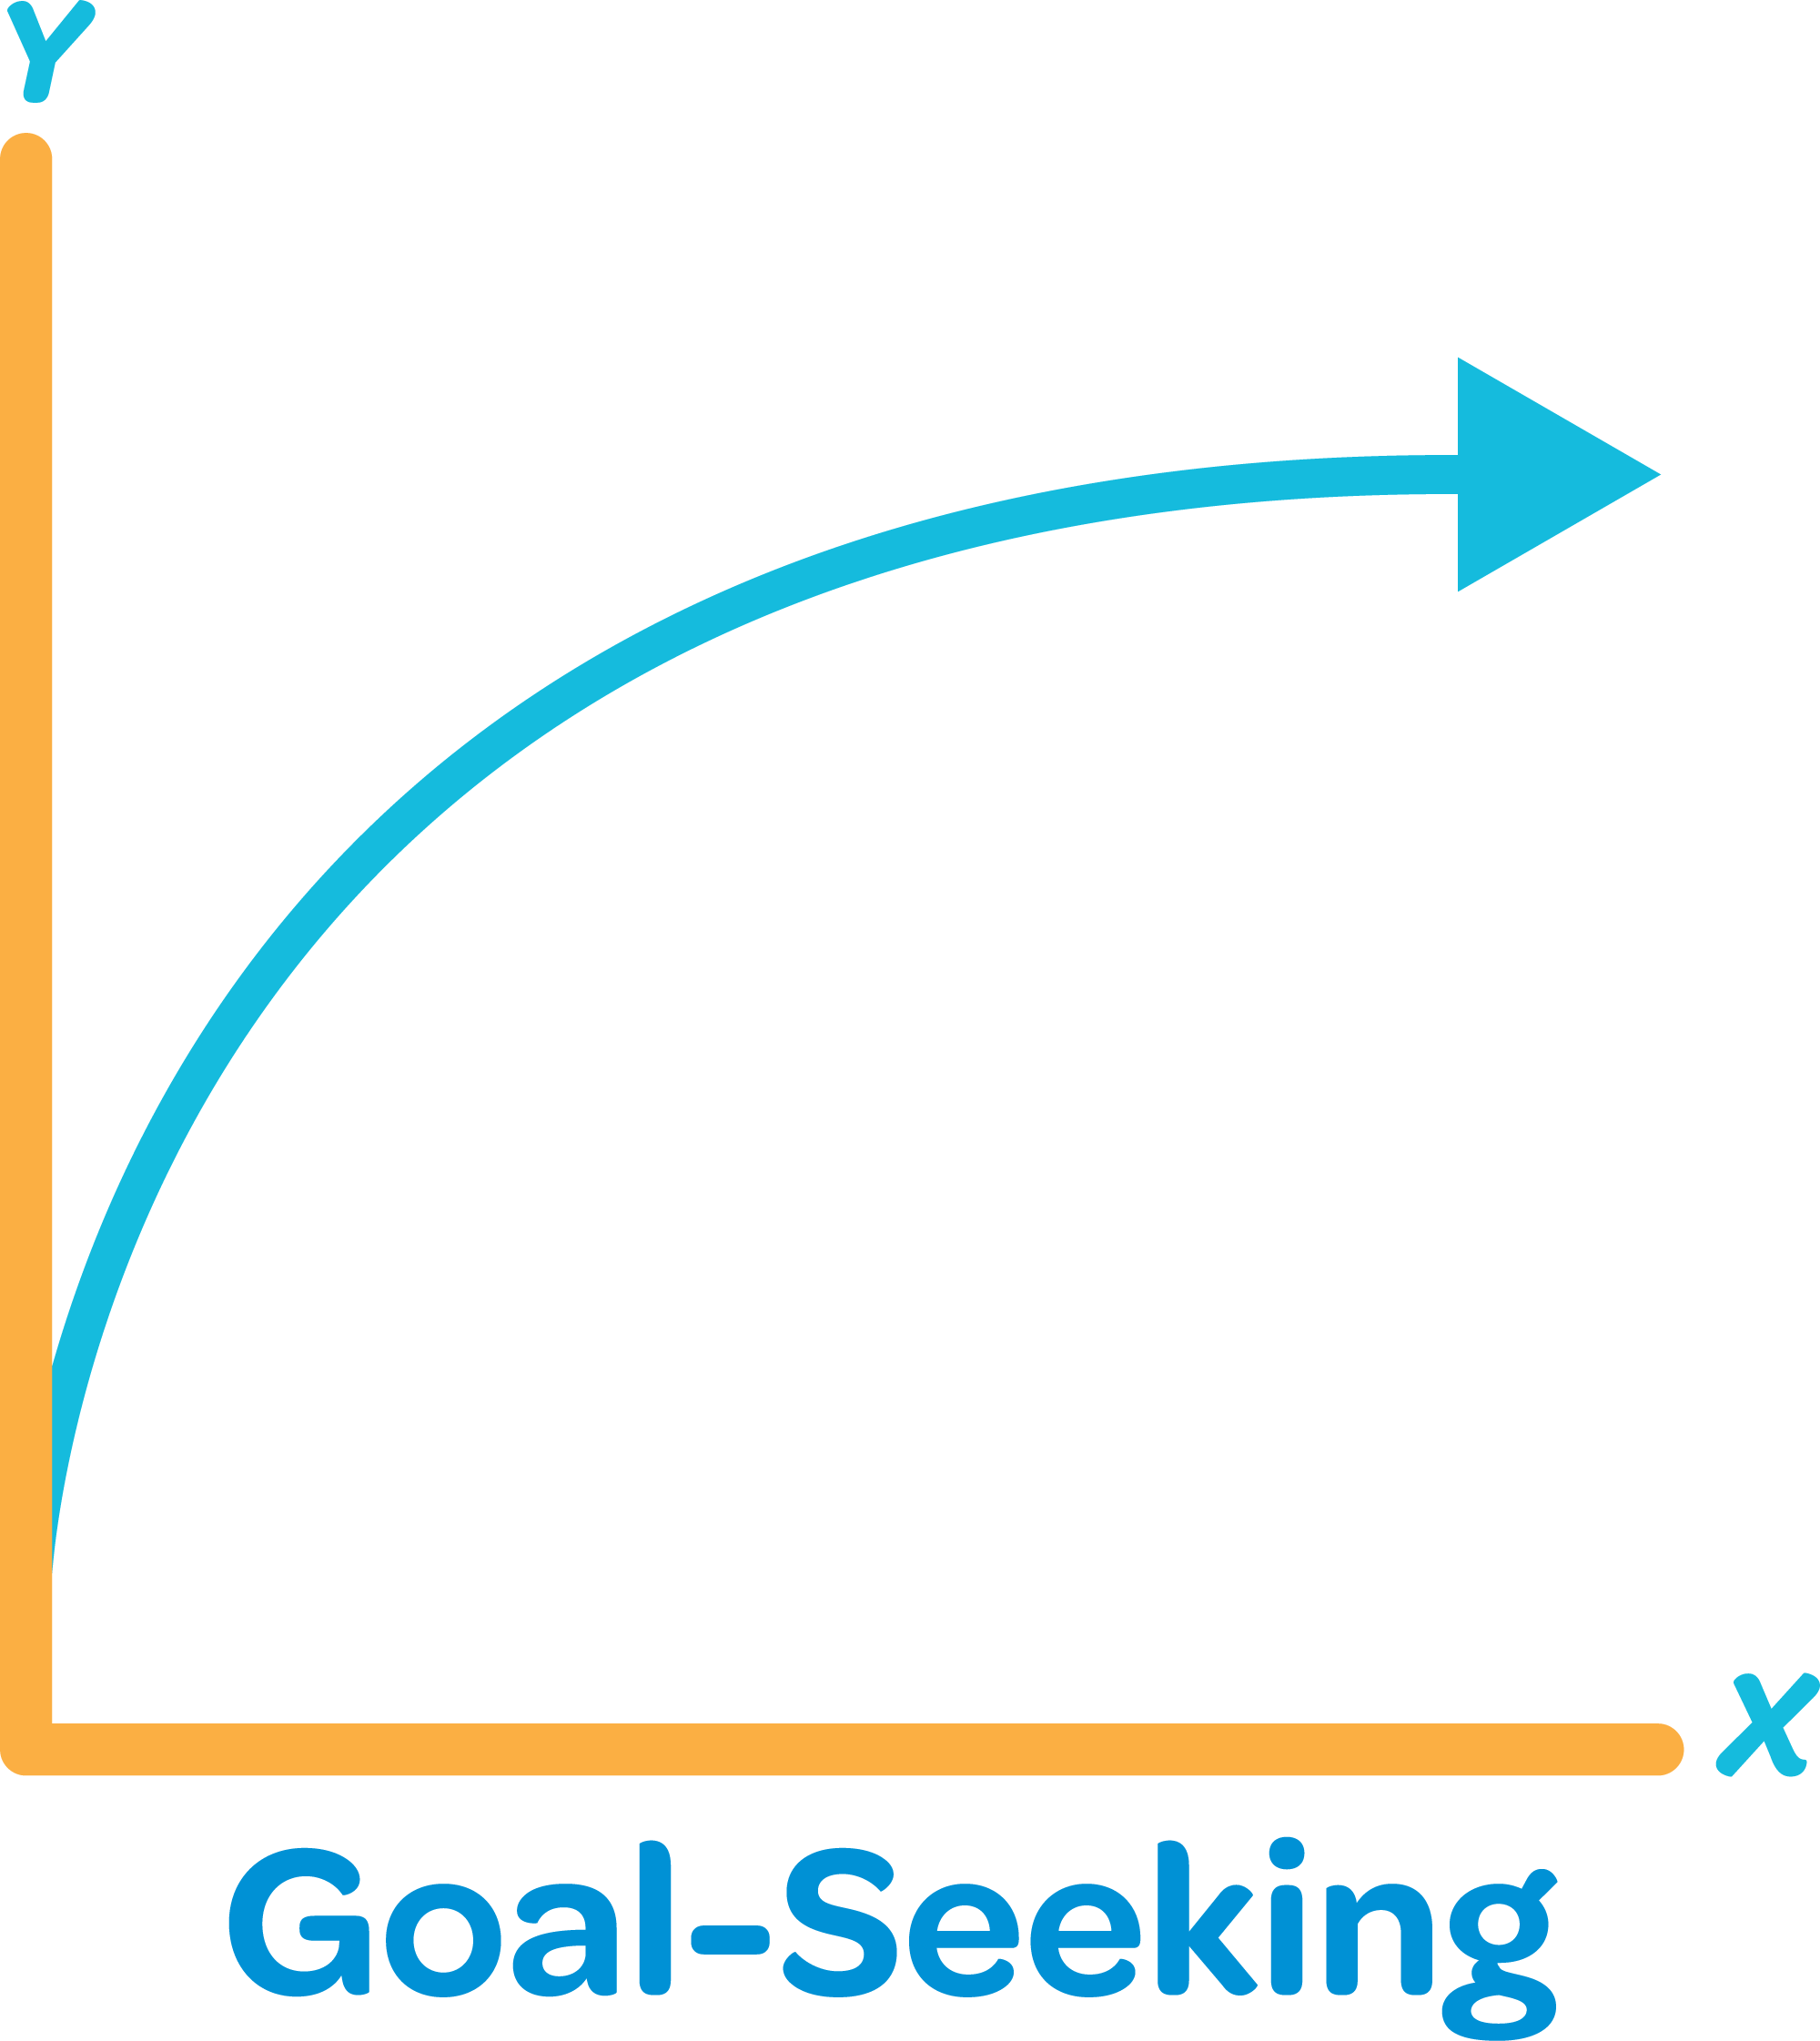
Balancing Feedback Behavior-Over-Time
Notes:
Brian- Balancing loops can produce oscillating behavior, but they can also seek an implicit or explicit goal, thus leveling out over time.

Slide 28
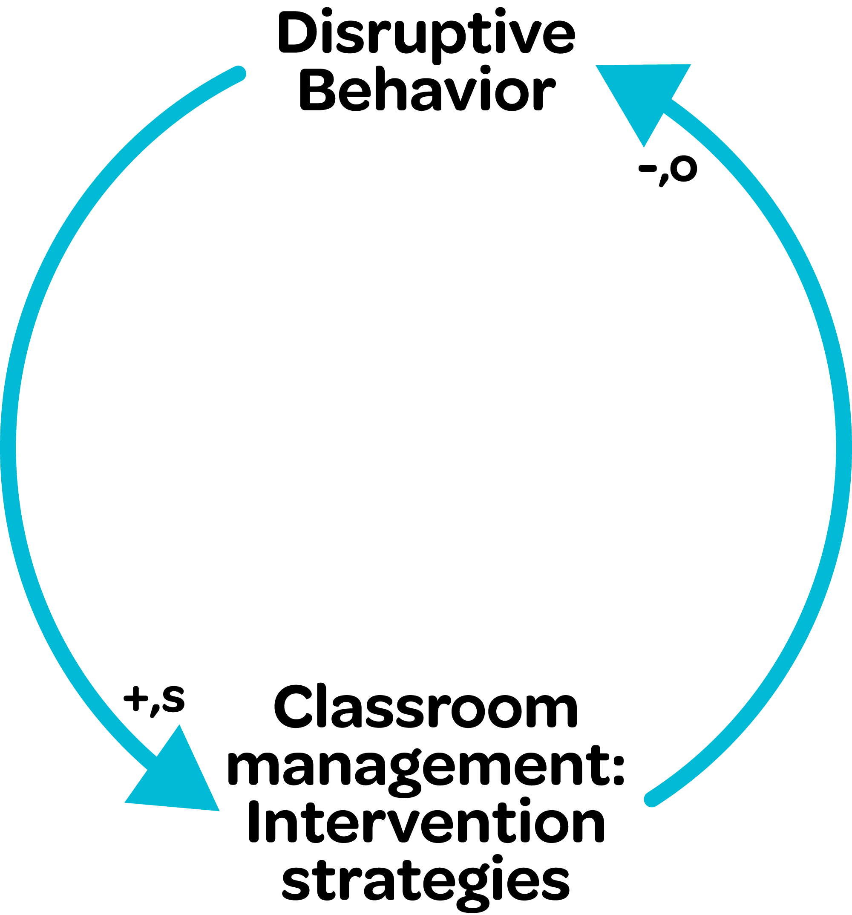
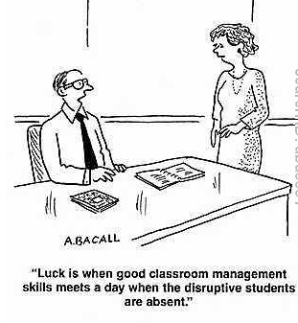
Balancing Feedback Causal Loop Diagram
- Artist, Aaron Bacall (cardstock.com)
Notes:
Brian-

Slide 29
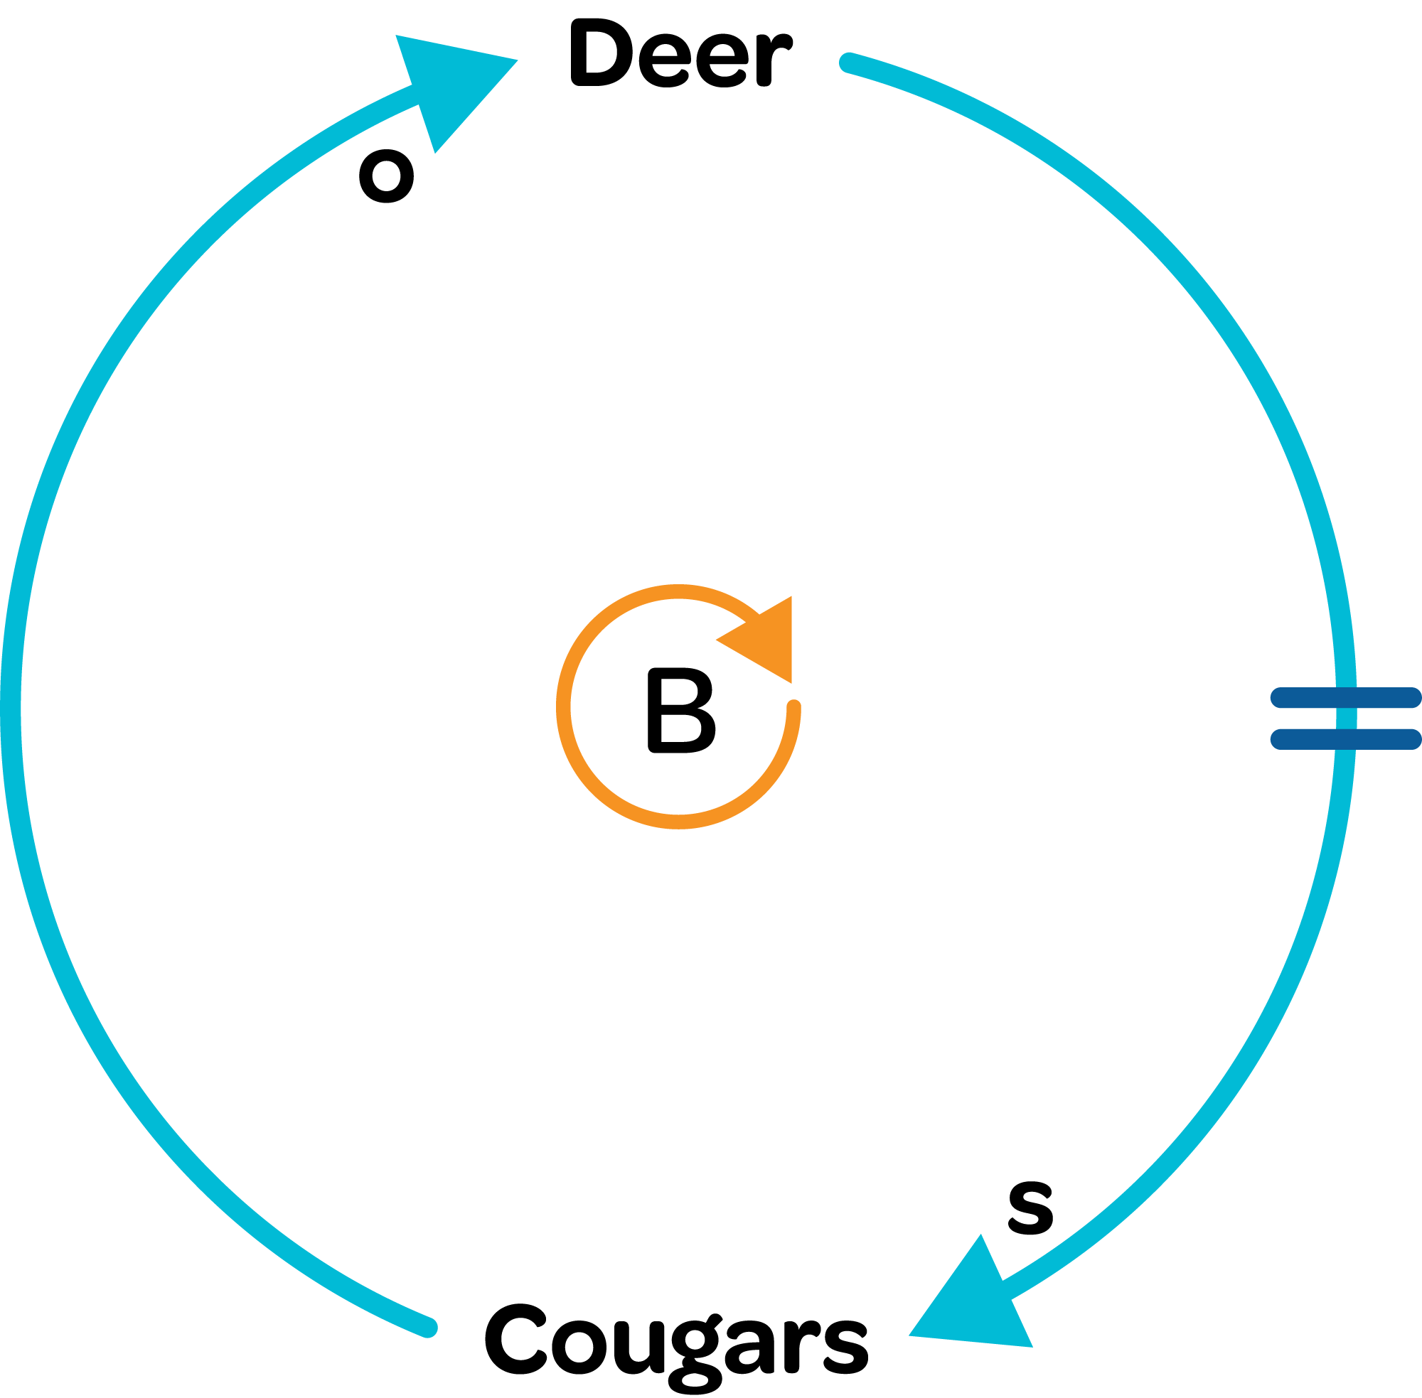
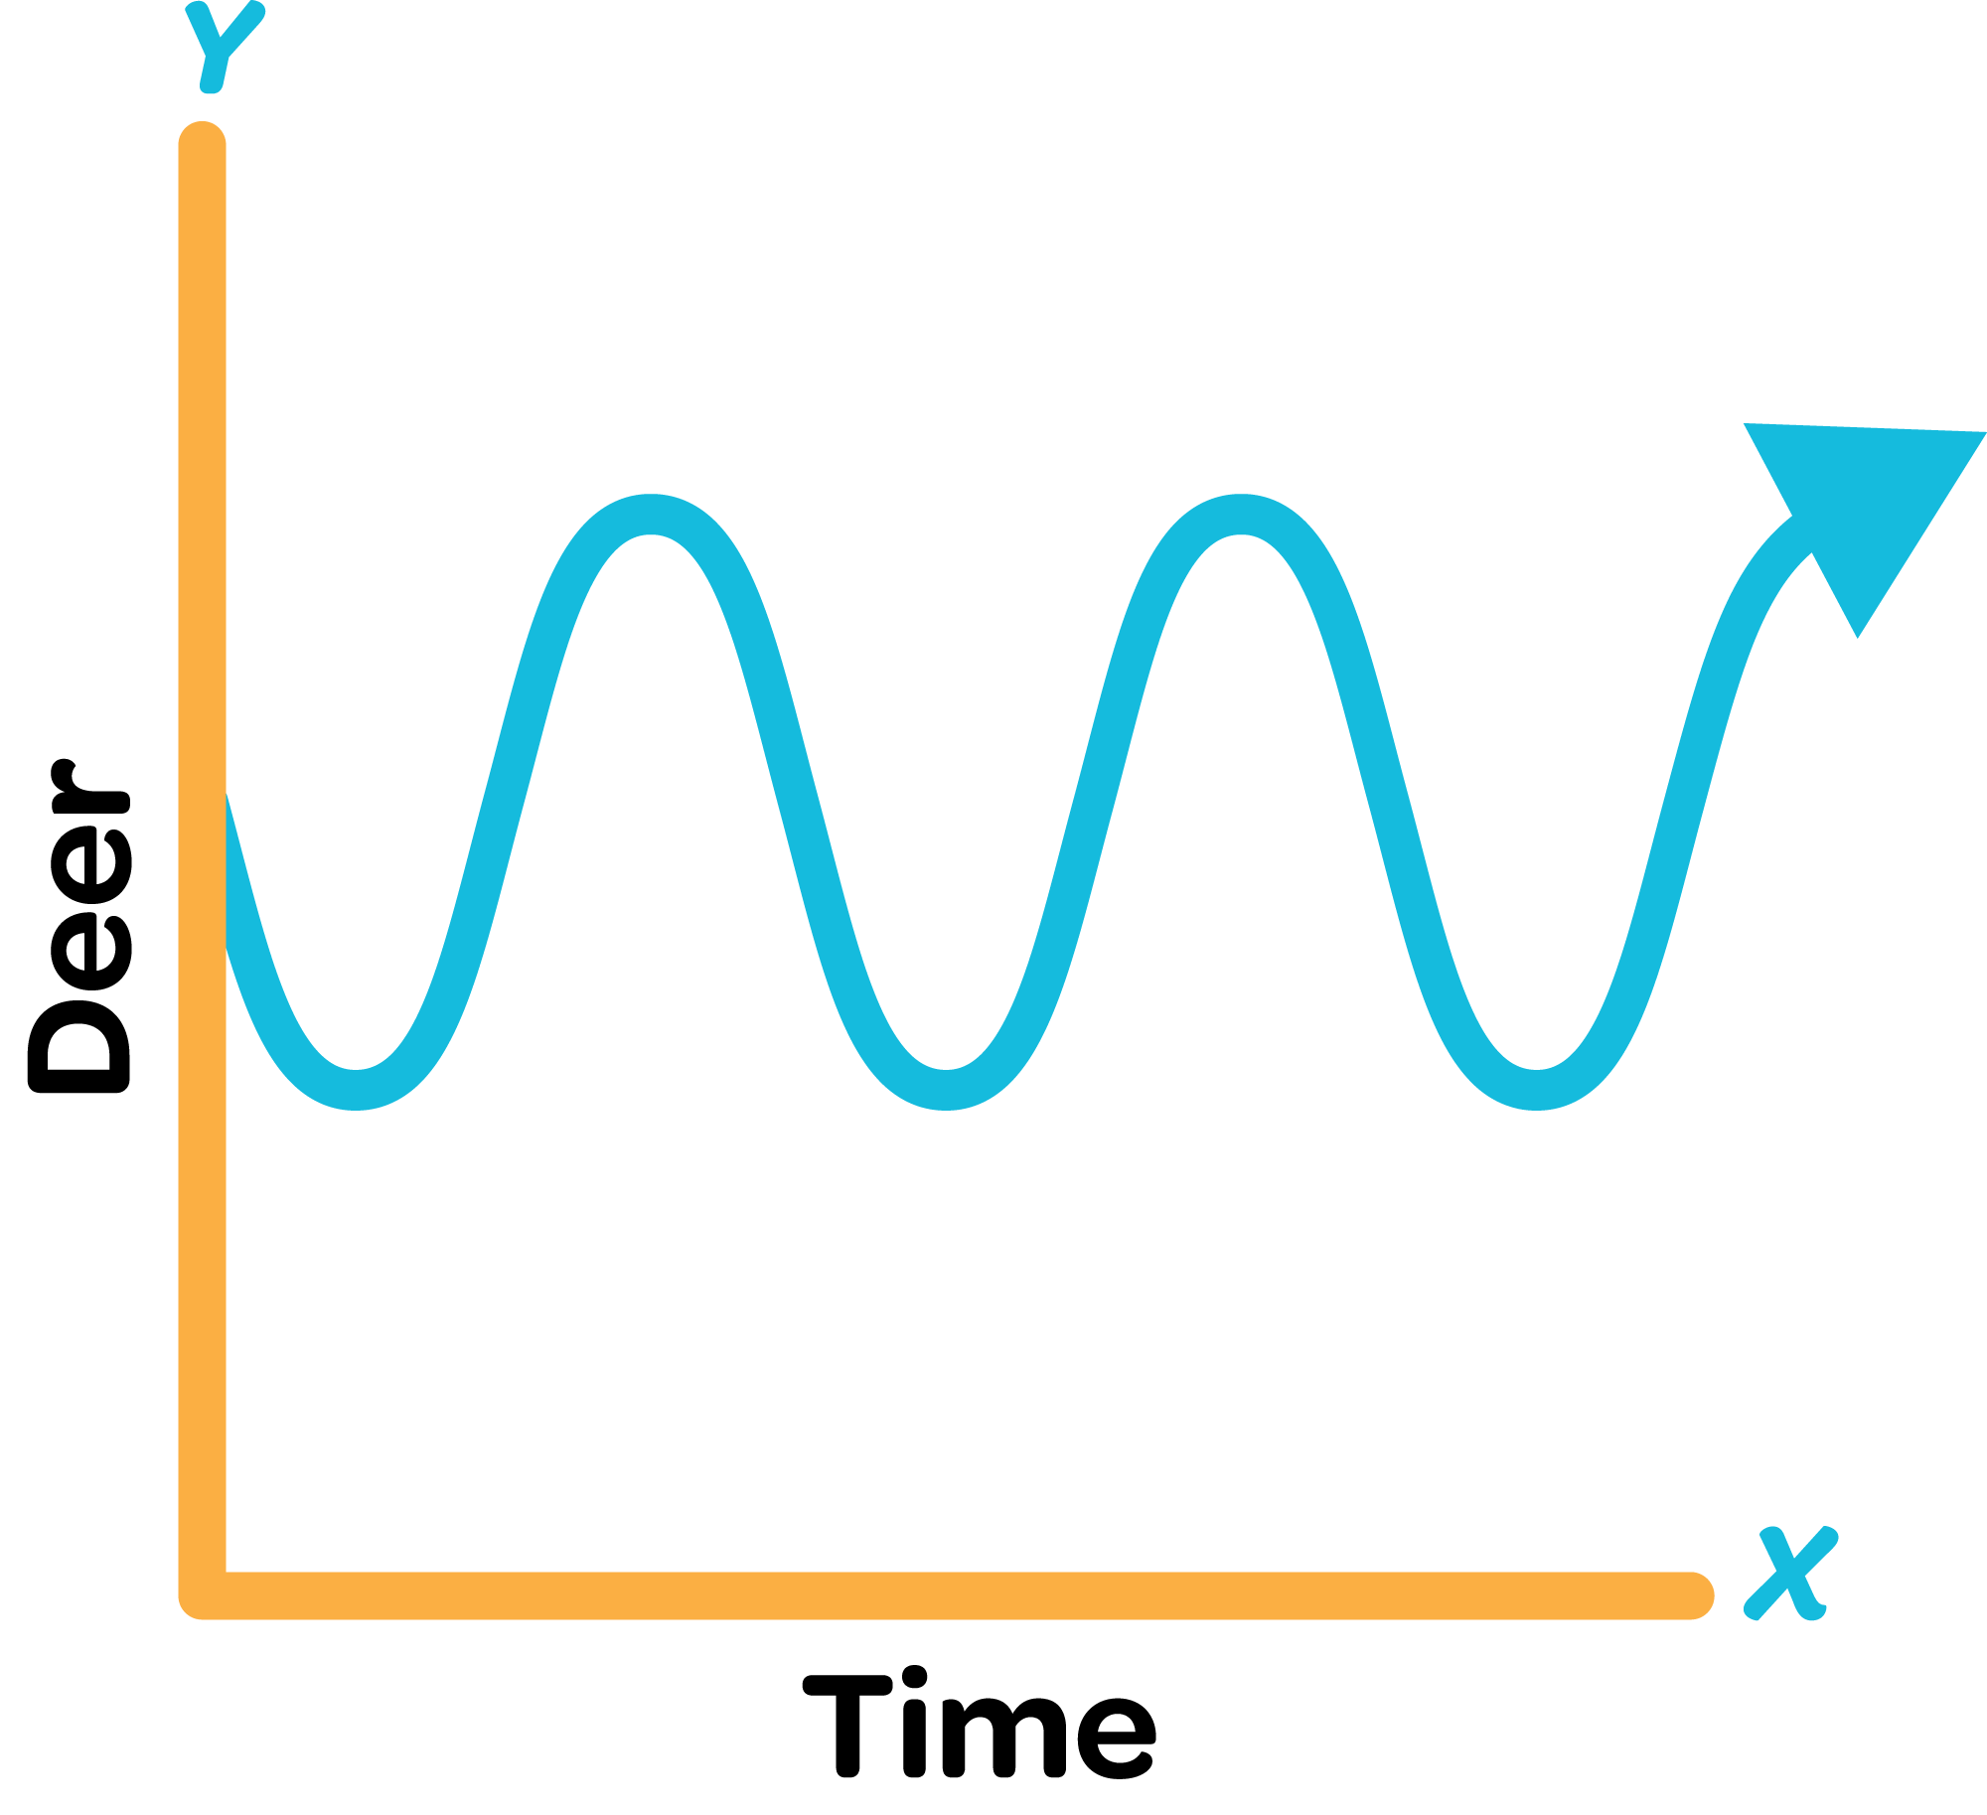
Balancing Feedback Causal Loop Diagram
Notes:
Brian- Read around this loop with the group more than once to see how the story changes dynamics. Use the thumb up/thumb down, but do point out the caveat about cultural sensitivity regarding use of certain hand gestures within different cultures.
Balancing dynamics will give you a BOTG that oscillates or approaches a limit. Also, a good “cheat” is that if you have an odd number of “o”s or “-”s in a loop it will be a balancing loop.

Slide 30
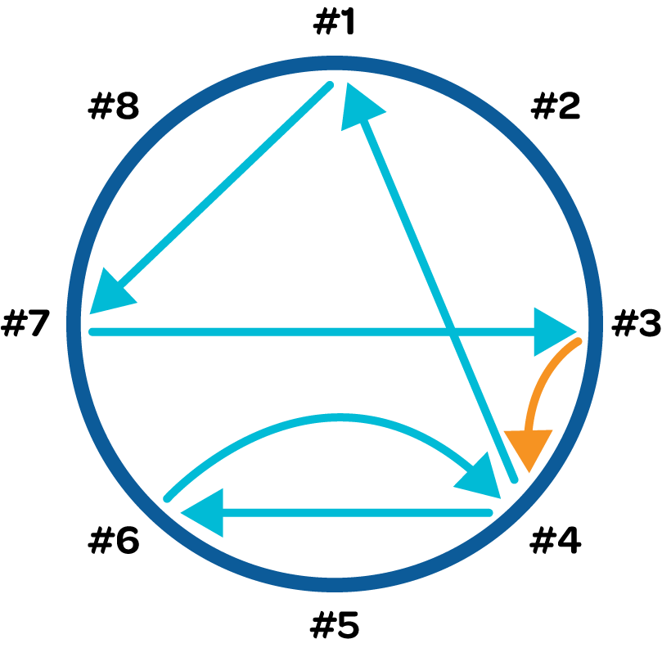
#1
Notes:
What two loops do you see? Draw on board.

Slide 31
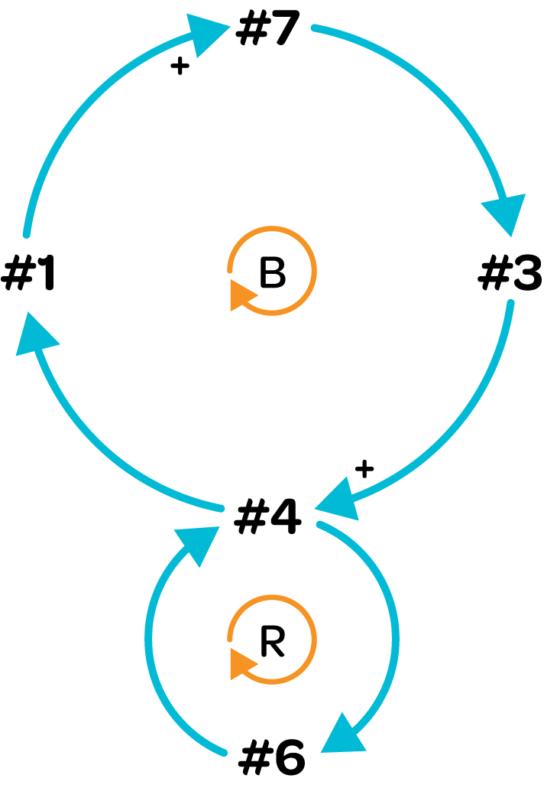
4

Slide 32
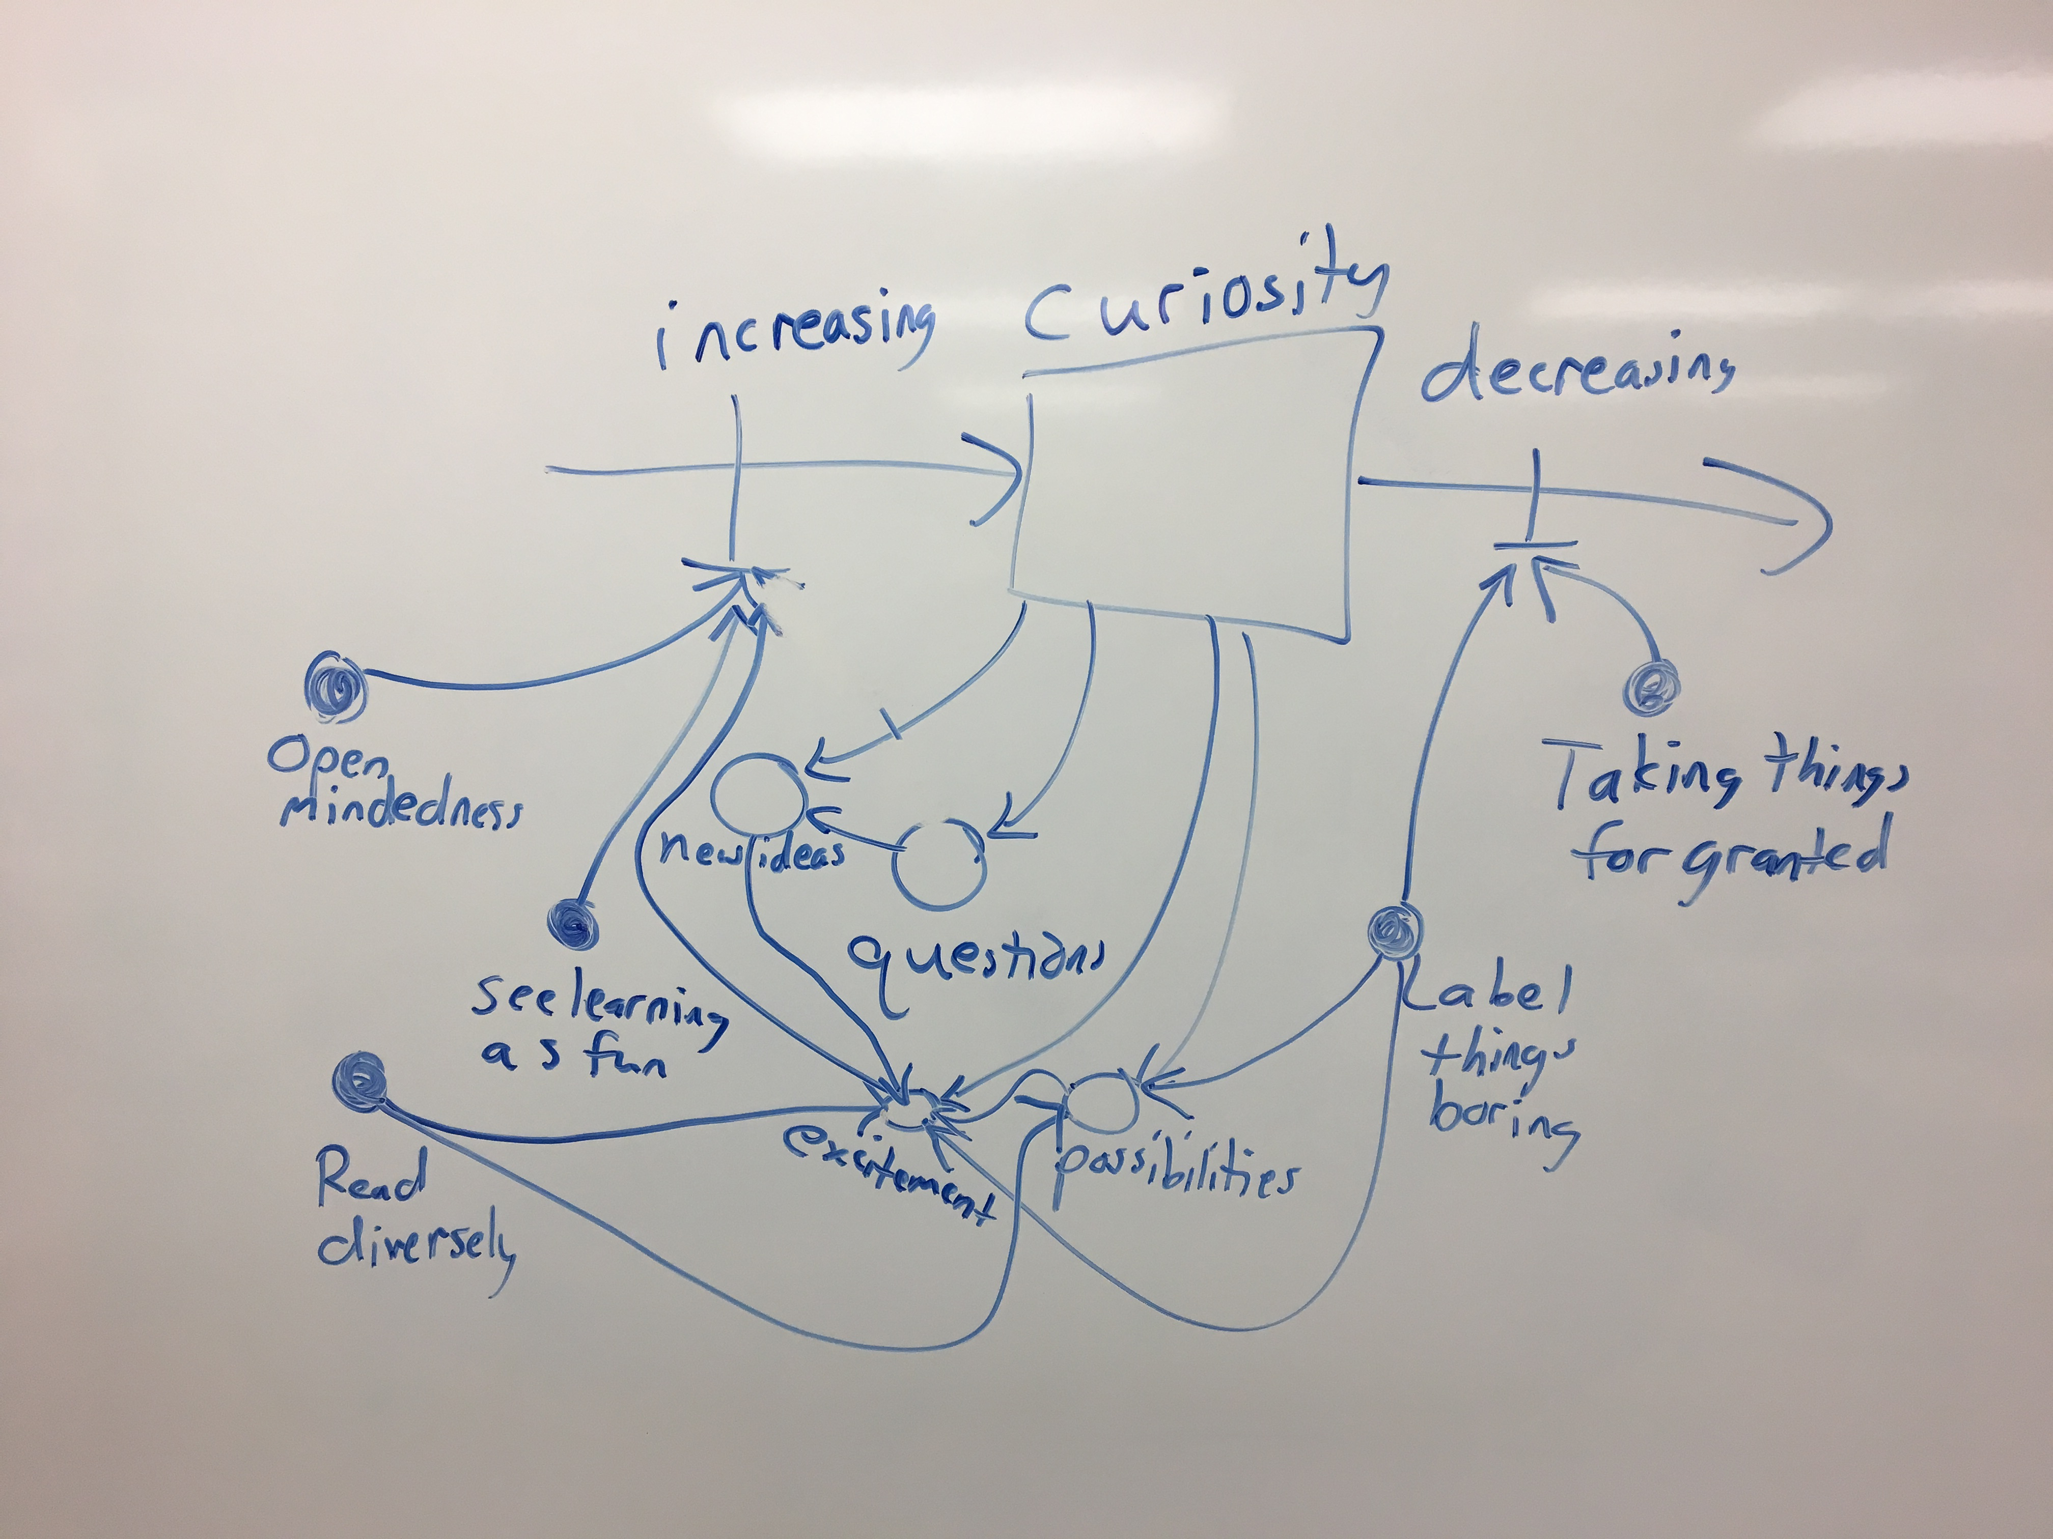

Slide 33
